Slide 1
Innodisk Corporation

Slide 2
About Innodisk
Innodisk is a service-driven provider of industrial embedded flash and DRAM modules, Server DRAM, embedded peripherals products and technologies, with a focus on the enterprise, industrial, cloud, and aerospace and defense applications.

Slide 3
Company Snapshot
Founded
2005
Capital
USD $20.7M
Revenue
USD $146M (2015)
Employee
434
Intellectual Patents
62
Production Capacity
600K / Month
XiZhi District, New Taipei City
Product Lines
Industrial-grade flash, DRAM,
Server DRAM, and
embedded peripherals
(K)
146M
Branch Offices
USA / Europe / Japan / China
Certifications
ISO 9001 / ISO 14001 / ISO 14064-1
IECQ QC 080000, TS 16949

Slide 4
Milestone
Listed on GTSM
Embedded Peripherals BU Set Up
Cloud Storage Technology Center Set Up
Founded in Neihu
Technology Park
Expanded to XiZhi Office
(HQ)
Acquired Actica Inc.
Established China Branch
2005
SMT Line Set Up
Merged Jmau Technology
2013
2011
Listed top Asia's 200 Best Under $1 Billion by Forbes
2007
2009
2015
Established Firmware Team
Intel Approved
Microsoft Partner
Concentrated on Embedded Industry
InnoRobust
SATADOM
Best Choice
2006
2010
2008
2012
Expanded to Nangang Office
ERP Implementation
Established Japan Branch
2014
ISO9001 Certification
Established USA Branch
Established Europe Office in Netherlands
Moved to XiZhi New Office
Established Aetina Subsidiary
Established AccelStor Subsidiary

Slide 5
Global Operation and Local Support
Europe Branch
Beijing
Japan Branch
US Branch
New Jersey
Shanghai
Shenzhen
Branch
Taipei
Headquarters
4 Branch Offices
8 Sales, Marketing and Service Support Centers

Slide 6
Our Brand Promise
Today’s global economy is ever-changing, and we take great pride in being extremely nimble.
Improvement and innovation are not just buzzwords to us. They’re something we live and breathe every day.
Listen and Response
Can,
not Can’t
We take on big customer challenges and creatively develop solutions.
Being responsive to our customers is not just important —it’s essential.
Stay Nimble
Keep
Improving
Absolute Service™
Service is not just what we do. It’s who we are.

Slide 7
Our Advantages
With over 62 product design patents, we develop innovative technology that enhances and benefits industrial applications.
Firmware
Team
Our in-house firmware team has years of customization experience.
This dedicated team responds quickly and accurately to customer requests and delivers highly reliable tailor-made solutions.
Intellectual
Property
All Innodisk products are manufactured in our own industrial-grade factory. To be more specific, We utilize advanced production technology in both
pre- and post-production stages to improve the protection of components.
Purpose-Built
Factory

Slide 8
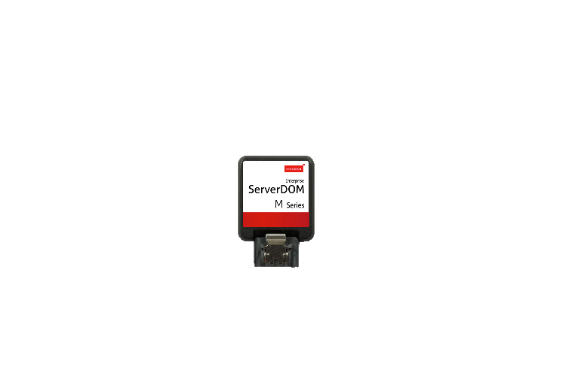
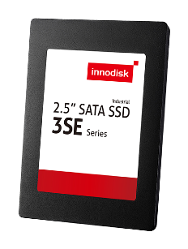
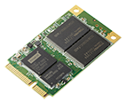
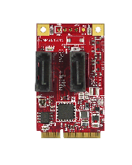
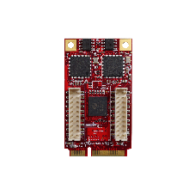
Product Lines
DRAM
Embedded / Wide Temp./ Coating / Server
Accelstor
FlexiArray SE110
Product
Lines
Flash
SATADOM / SeverDOM™ /mSATA…
AETINA
EP
mPCIe Storage / Communication /
Display Modules
Computing Graphic Card

Slide 9
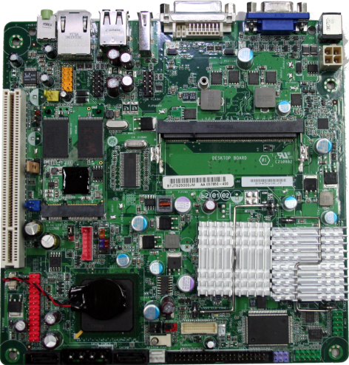
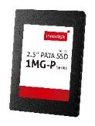
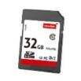
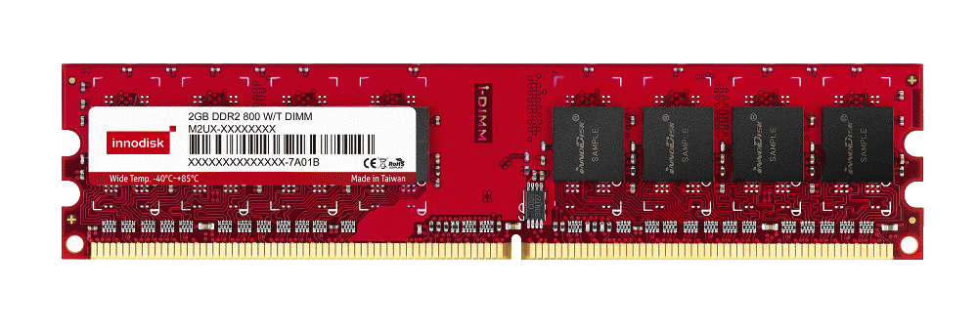
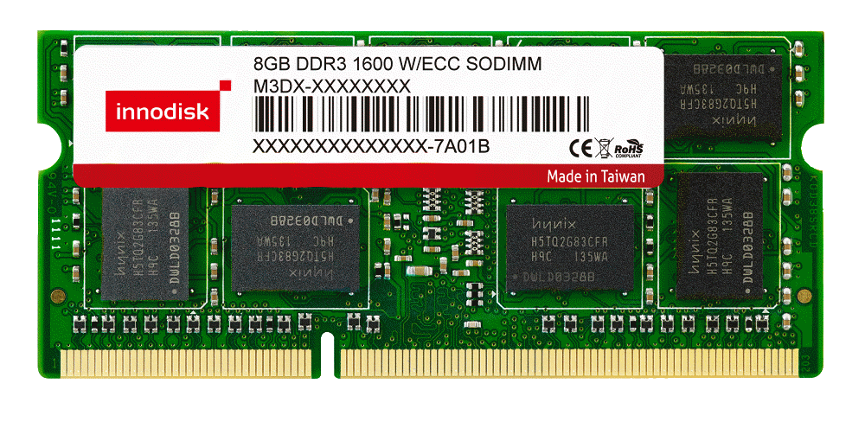
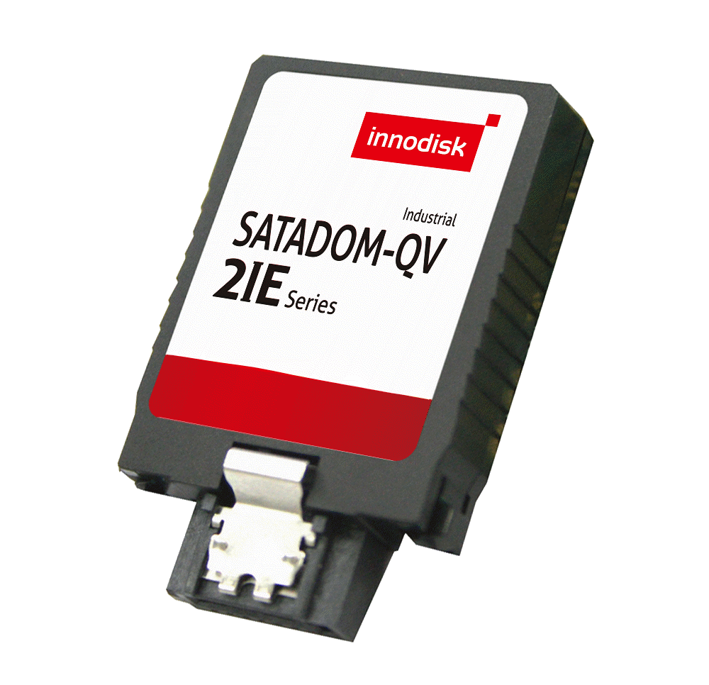
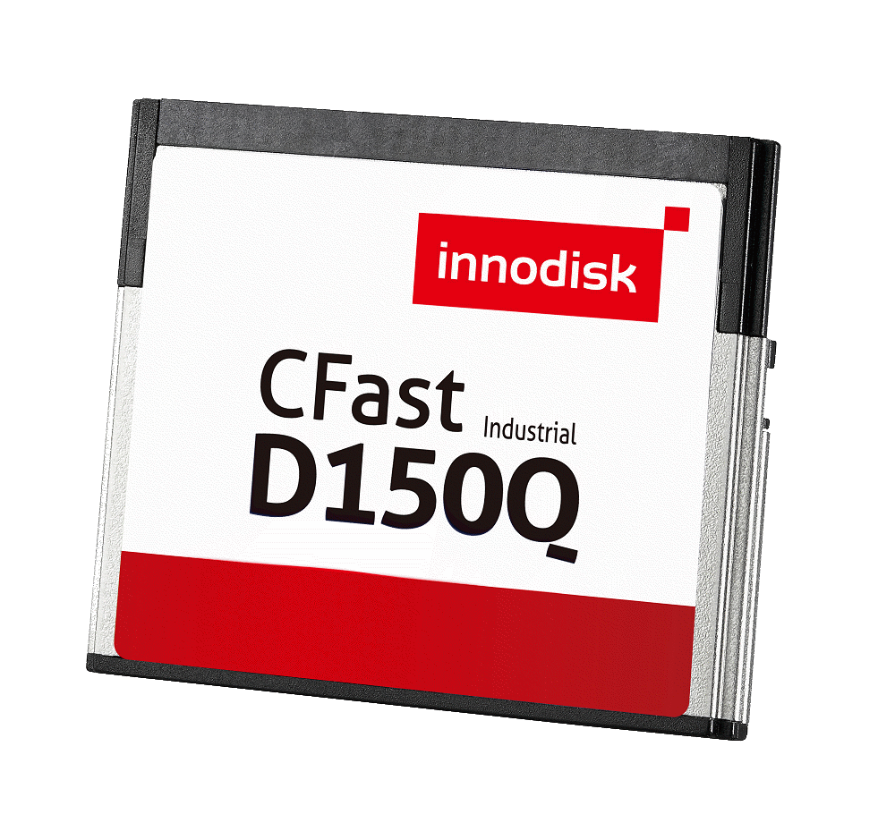
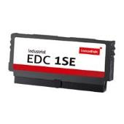
Complete Storage Solutions
1.8” SATA SSD
2.5” SATA SSD
USB Module
SD / micro SD
DRAM
SATADOM
mSATA, SATA Slim
CFast
nanoSSD
PATA CF/EDC

Slide 10
Our Expertise and Service Support
Semi-
Industrial
Vertical
Markets
Mission-
Critical
Cloud
Applications
Embedded
IPC
POS
Gaming
Aerospace
Server
Automation
Kiosk
Medical
Defense
Surveillance
Digital Signage
Networking
HPC
Security / Endurance
Customization / Longevity Support
BOM Control / Firmware Support
Product Performance and Reliability

Slide 11
Our Software Services
iService is a dedicated software service for industrial systems
iService
System Builder Development
Software Consulting Service
Software Tools
Windows & Linux
iSmart & iCover
Support & Training
An O.S. image customized and validated for various platforms and systems
Turn-key solutions that delivers robust, high-quality, customized applications
Our extensive knowledge based enables customers to quickly find the best solution

Slide 12
Proprietary Technologies and Patents
A patent technology used to eliminate the need for power cables, which makes SSDs more shock-resistant and better suited for extreme environments.
An exclusive technology that provides longer-lasting and more reliable performance than conventional MLC NAND flash by leveraging our firmware know-how.
Patents
62
A powerful health monitoring tool that allows system
Integrators to track disk information, such as temperature, storage space, bad blocks, lifespan on one platform.
Data protection technology built into SSDs for
mission critical applications.
Provides a mechanism to instantaneously
discharge data stored in temporary volatile DRAM buffers to ﬂash storage, to ensure the safety of data during power failures.

Slide 13
Complete Vertical Solutions
13%
14%
Embedded SI
10%
IPC
Thin client
16%
Automation
9%
Gaming
4%
7%
Energy
POS
5%
8%
Networking
Medical
6%
8%
Aerospace & Defense
Other

Slide 14
Strategic Partners

Slide 15
Partner Endorsement
In 2012, Innodisk SATADOM was recommended by Intel and exclusively applied to Romley sever platform.

Slide 16
Forbes Asia’s 200 Best
In June 2015, Innodisk was listed as one of Asia’s 200 Best Companies under $1 Billion.

Slide 17
Our Factory
Our industrial-grade factory to ensure consistent product quality, and provides flexible production that caters to our customers’ needs, as well as increases productivity, provides on-time delivery, and steady continuous product supply.

Slide 18
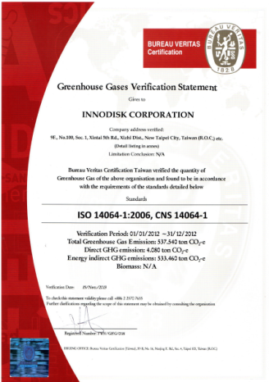
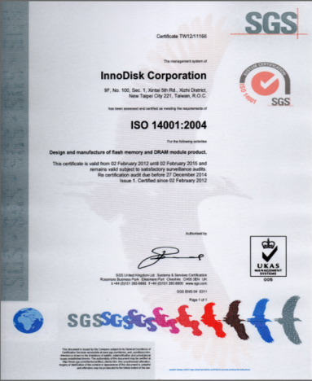
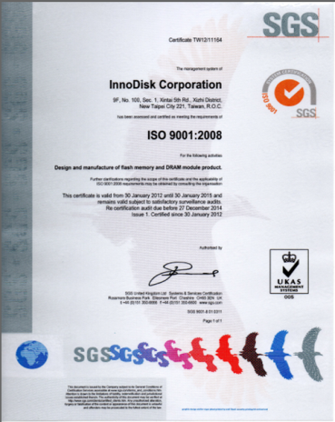
Production Capacity and Certifications
ISO9001 X ISO14001 X IECQ QC080000 X ISO14064-1
TS16949

Slide 19
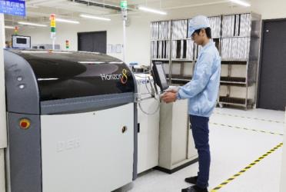
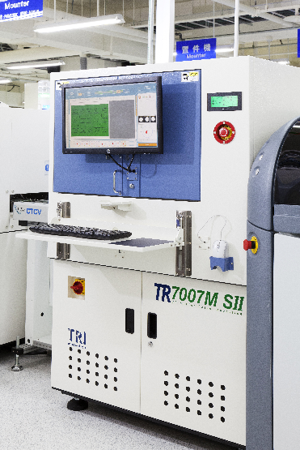
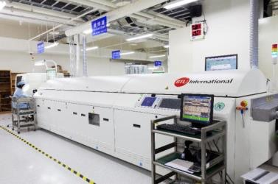
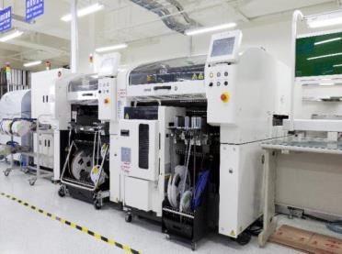
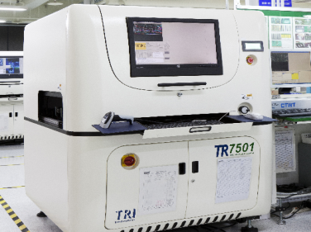
Manufacturing Facilities
Solder Paste Print
Reflow
Pick & Place
SPI
AOI

Slide 20
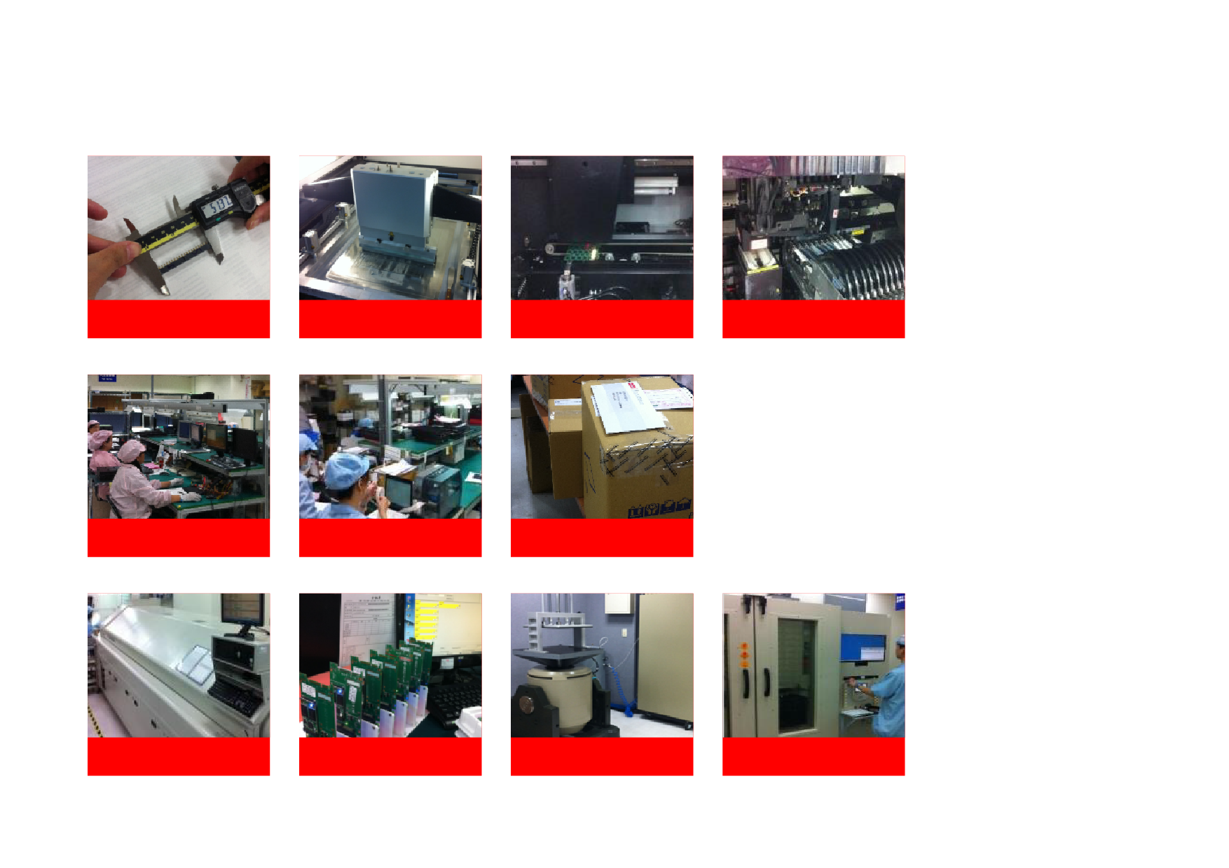
Production and Quality Control System
IQC
SMT- Printing
SMT- SPI
SMT- Mounting
PQC
Packing
Warehouse
SMT-Reflow
MP
Vibration
FT / Burn-in

Slide 21
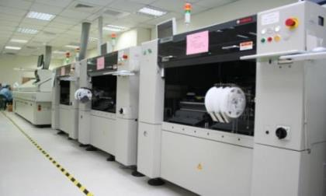
Production and Quality Control System
MES
E-control
System
Production Management
Quality & RMA Control
Shipping Management
Quality
Management
ISO
9001:2008
Factory
IQC
QQC
FQC

Slide 22
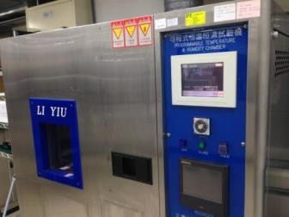
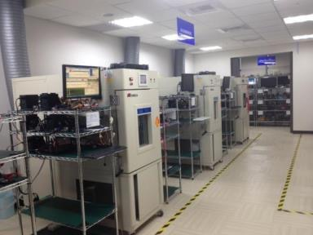
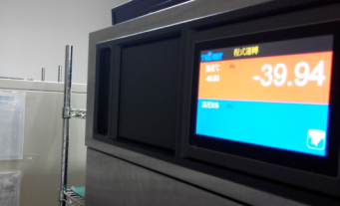
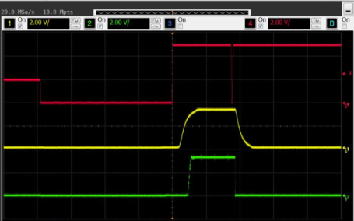
DQA & FAE
DQA
Chambers Temperature Test
FAE
Environmental Condition Simulation

Slide 23
Our Value to You
Fixed BOM
Industrial-grade
factory
Ensures consistent product quality to support customer validations
Full quality control through in-house production and testing
Technical
Support
Responsiveness
Customization
Provides local service through service centers in regions
Quickly recognizes customer challenges and delivers timely solutions
Fulfills customer requests quickly with reliable tailor-made solutions
Longevity
Support
Provide long product supply to support customer’s businesses
In-house
Firmware
Team
Financial
Stability
Provides responsive, dedicated, and solution-driven support
A listed company with the Taiwan stock market (GTSM: 5289)

Slide 24
Our Successful Stories
We have developed strong cases in vertical markets by understanding customer requirements and providing the timely response and solutions.

Slide 25
iSLC Products Manage the
Challenges of Heavy Write Loads with an Economic Solution
The Situation
A customer in the gaming industry chose MLC SSD for boot loading and data storage application in digital casino slot machines. When testing and simulating the usage environment, we found the write workload reached 6,000 program erase cycle in three months, which surpassed the MLC SSD’s regular lifespan.
The Solution
Although SLC is considered as an ideal solution for solving heavy write loads, the high cost is of concern to the market. Therefore, Innodisk provides the iSLC SSDs solutions by enhancing the MLC performance similar to an SLC flash-based solution via our firmware capability. Our iSLC can surpass 20,000 Program/Erase (P/E) cycles in average, which is a huge increase in lifespan over MLC flash based drives.
The Result
Innodisk’s iSLC solution solves challenges of heavy write loads, the SSD lifespan is 7 times longer compared to the standard MLC SSDs, which makes it more affordable in the market.

Slide 26
Innodisk’s ULP Mini-DIMM
Benefits Media Processing for
Telecommunication Companies
The Situation
Our Korean customer acquired a project to work on media recording systems for a telecom company. The systems used to process large and numerous files at high speeds with zero delays or interruptions. Therefore, they need powerful and reliable DRAM with ECC function for streaming usage in an 1U server system.
The Solution
Innodisk’s Mini-DIMM series with very low profile (VLP) is designed for communications applications. This DRAM module series is ATCA compliant and only mere .70” tall, making it suitable for the most space-constrained blade servers, routers, telecommunications, and networking devices. In addition, the Mini-DIMM modules can reach 8GB capacity for higher memory densities.
The Result
By having the exclusive specifications like ATCA compliance, VLP height, and extreme high capacity, our Mini-DIMM is tailor-made for communication applications

